Slide 1
MakeMyStudyPlan
EduTech AI Study Planner Platform
Revolutionizing Personalized Learning with AI
Name : Prem Jadhav
Guide :

Slide 2
Introduction
Transforming Personalized Learning through AI
Our EduTech AI Study Planner is a state-of-the-art platform that develops personalized learning pathways for students in technical and non-technical courses. Through the use of AI capabilities, we provide:
•Individualized study plans from personal assessments
• Dynamic learning pathways that change with student advancement
•Specially designed timelines based on learning objectives and time limitations
•Detailed progress monitoring and skill verification
•Community-spurred motivation with focused leader boards
This platform addresses the critical gap between generic learning resources and the need for personalized education journeys that adapt to each learner's unique circumstances.

Slide 3
Abstract
"MakeMyPlan" is a platform that has integrated AI, which aims at simplifying the process of studying and monitoring personal study plans in a specific emphasis on Artificial Intelligence (AI) learning. Relying on advanced open-source Natural Language Processing (NLP) engines or Google Gemini API, the platform allows users to create customized study timetables based on the learning preferences and objectives of individual users. With the use of smart data analysis and learning algorithms that adapt to users' needs, MakeMyPlan is able to track user progress, offer instant feedback, and recommend changes to maximize learning. Built on the MERN (MongoDB, Express, React, Node.js) stack, the platform provides a smooth and scalable user experience and is well-suited for AI learners who want an organized and efficient way to learn AI principles.
Keywords : MakeMyPlan , AI integration , MERN stack , Custom Study plans

Slide 4
How It Works: AI-Powered Learning Journey
Step 1
Step 2
Initial Assessment –
Know Your Starting Point
We start by getting to know you as a student through a smart onboarding process:
1.Subject & Goal Selection: Select your subjects and define learning goals.
2.AI Knowledge Assessment: Intelligent strategies test your existing skill level.
3.Learning Style Analysis: Are you a practical learner or a theory-based learner?
4.Time Availability Check: We tailor your calendar according to how much time you can commit
AI-Generated Study Plan –
After evaluation, our AI designs an organized but dynamic curriculum based on:
1. Your quiz score and learning styles
2. Pre-existing knowledge graphs for every subject
3. Your own availability and time expectations

Slide 5
How It Works: AI-Powered Learning Journey
Step 3
Step 4
Progress Management -
1. Module completion tracking
View your live progress.
2. Validation of skills through quizzes
Support learning through topic-based challenges.
3. Flexible plan revisions
If you're doing poorly or well, your plan adjusts.
4. Calendar-based planning
Schedule studies with daily and weekly summaries
Engagement & Motivation :
1. Gamification and reward-based advancement
2. Location-based leader boards (city/state/national/global) to compare progress.
3. Real-time analysis to observe how you get better over time. Community recognition for having consistent study habits.

Slide 6
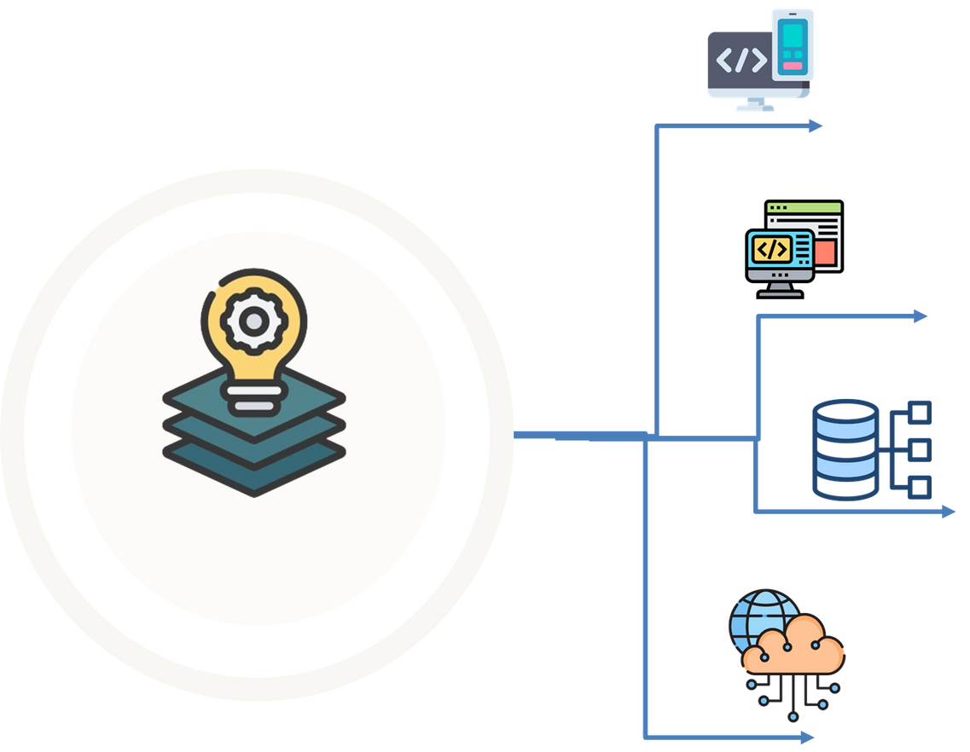
Tech Stack used in this Project
Frontend: React.js with Next.js , Tailwind CSS , Redux , React Calendar
Backend: Node.js with Express.js , MongoDB , Firebase , JWT authentication
Ai integration: Google Gemini API / OpenAI GPT API , TensorFlow.js , Custom NLP models
Cloud Infrastructure: AWS Elastic Beanstalk, AWS Lambda , Amazon S3 & CloudFront , Auto-scaling groups

Slide 7

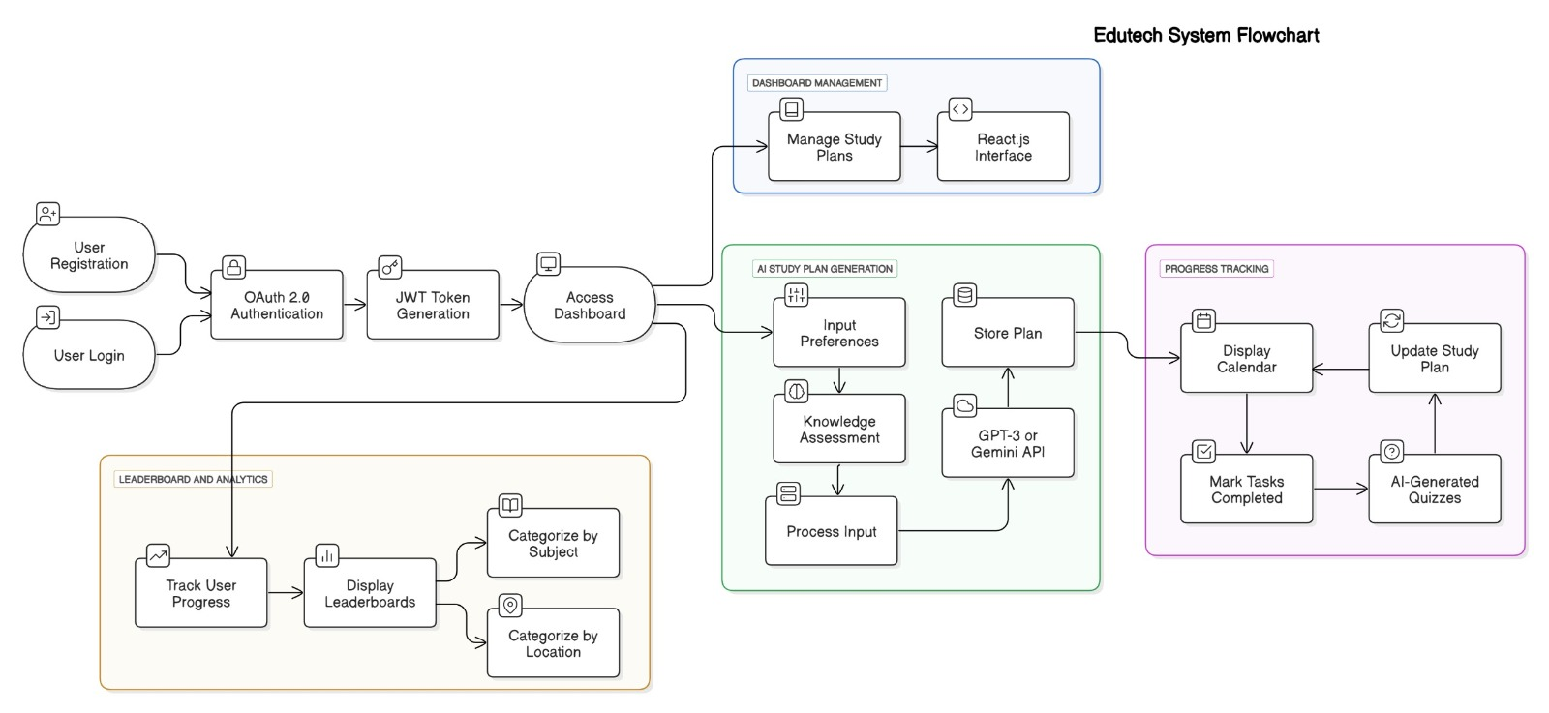
Architectural Diagram

Slide 8
Thank you!

